Slide 1

Online Shoppers Intentions
Shivangi Pokhriyal

Slide 2

Problem Statement
This is the data of an online retailing company where they are trying to find which online shopper will generate revenue by his/her online shoppers’ activity on their site.

Slide 3
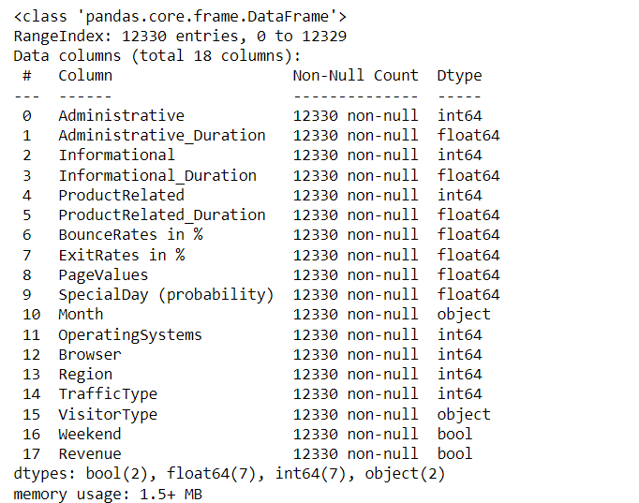
Structure of the Data
The data has 12330 rows and 18 columns.

Slide 4
DATA CLEANING

Slide 5
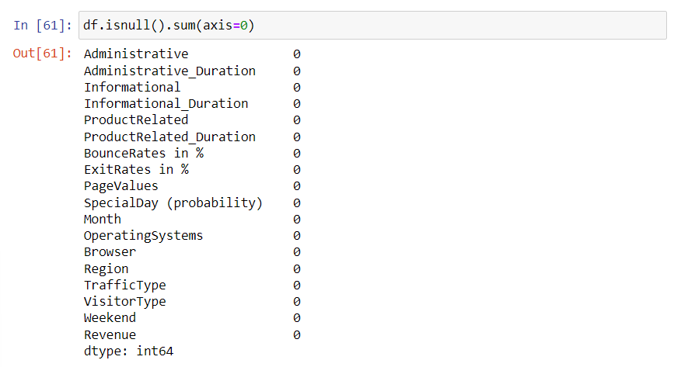
Null Values
There are no null values in the data that we are provided.
The columns OperatingSystems and Browser are irrelevant in this context and can be dropped out of the dataframe.

Slide 6
Label Encoding
The data type of VisitorType and Month is object. Since these columns contain qualitative data, they are needed to be encoded to quantitative data.
One hot label encoding technique is used for transforming VisitorType Column.
Month column is transformed to their corresponding month numbers using a custom function.
To avoid multicollinearity issues , VisitorType and Other columns are dropped from the dataframe.

Slide 7

DATA VISULAIZATION

Slide 8
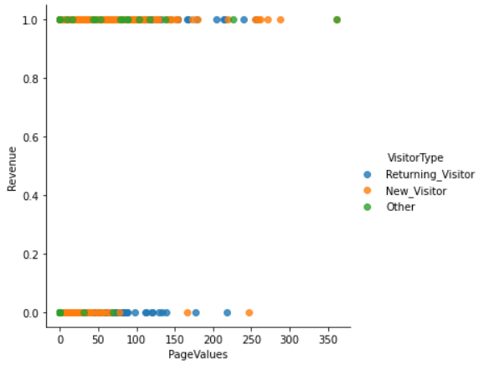
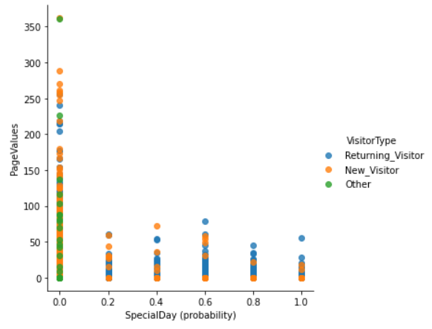

Slide 9
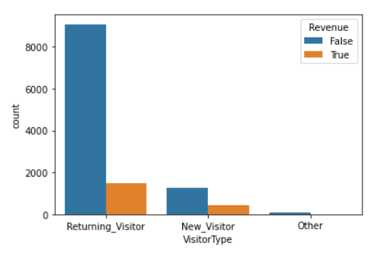

Slide 10
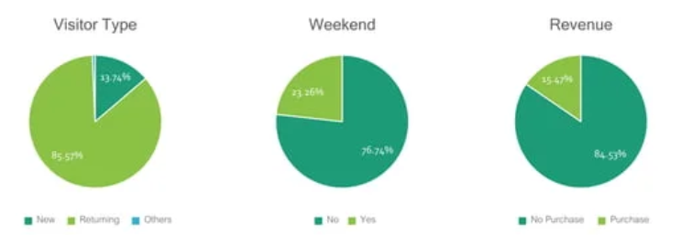

Slide 11
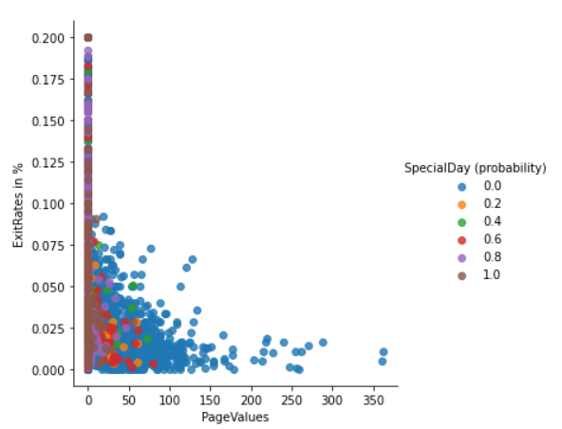
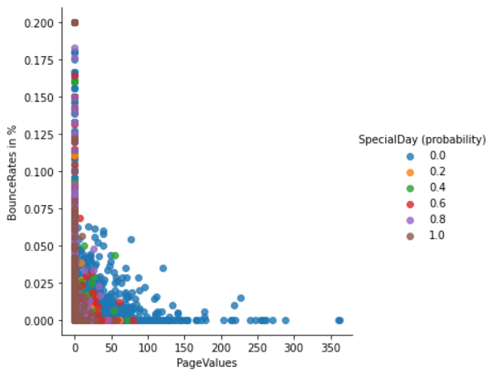

Slide 12
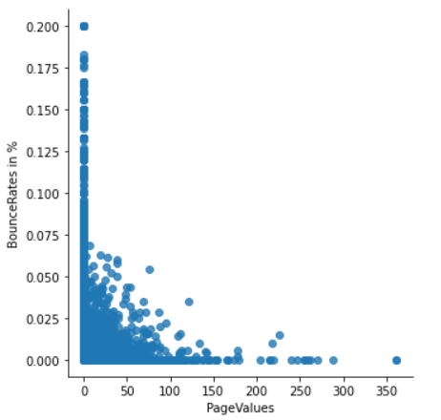
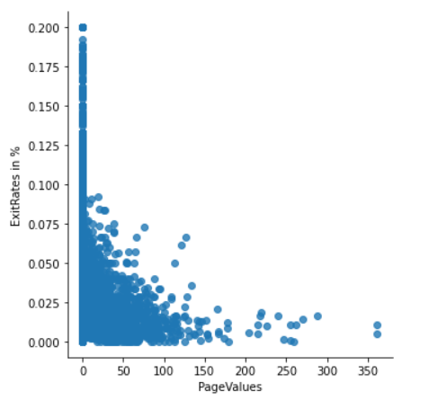

Slide 13
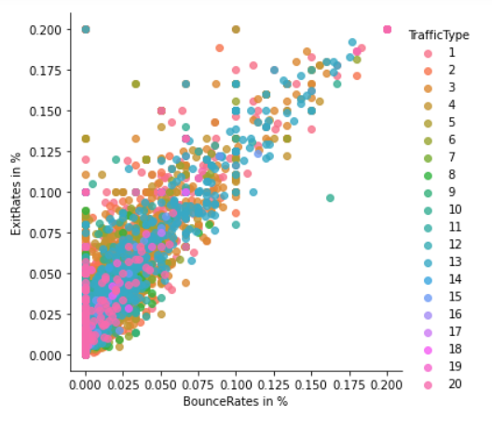
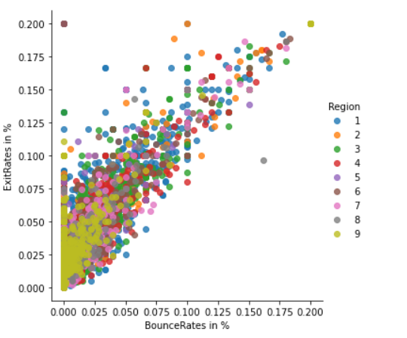
BounceRates vs ExitRates

Slide 14
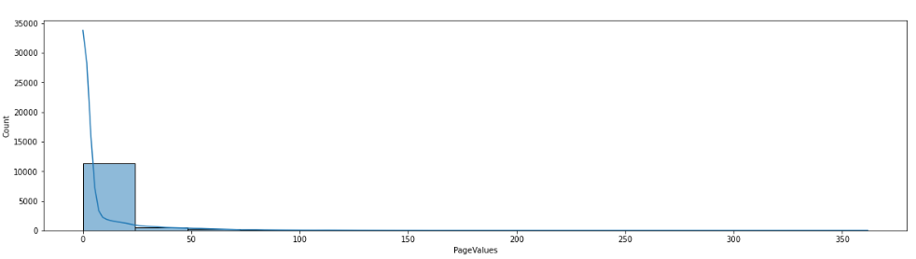
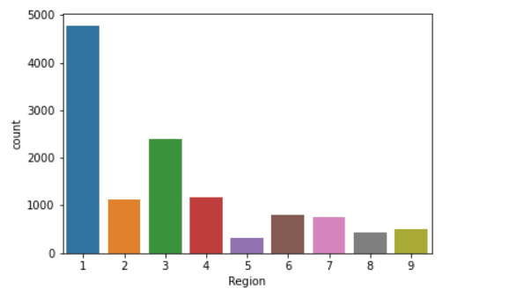

Slide 15
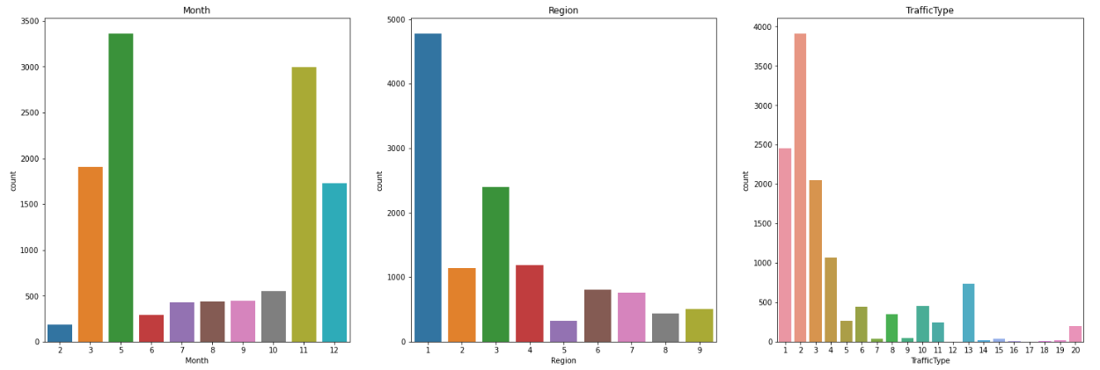

Slide 16
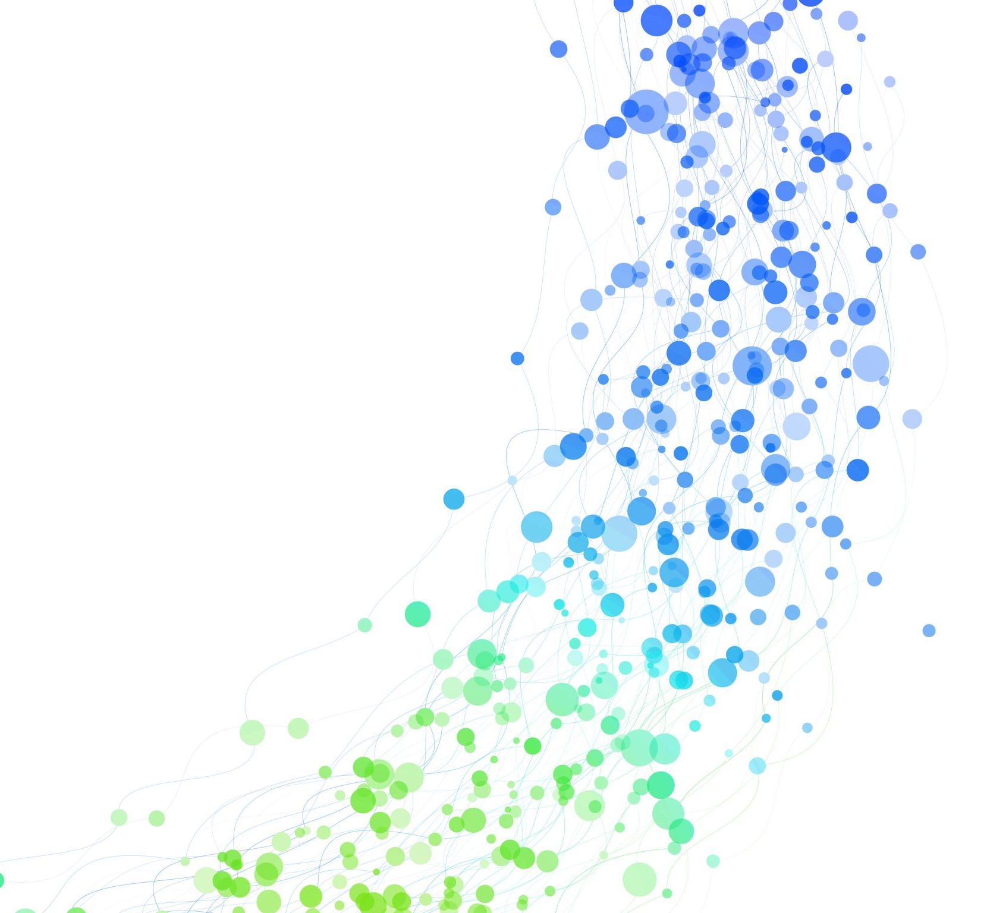
OUTLIERS’ TREATMENT

Slide 17
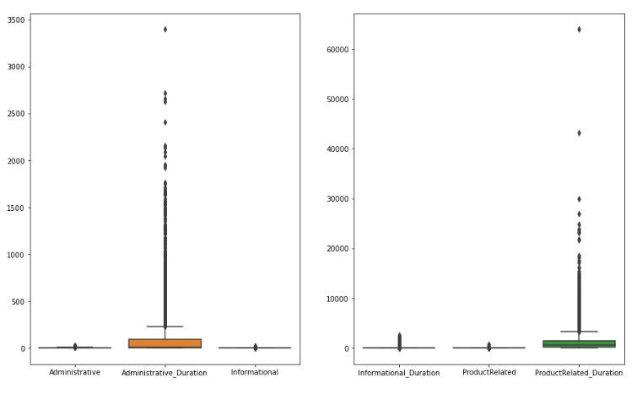
Checking for Outliers
Plotting boxplots for all non-categorical columns of the data to determine the presence of outliers.

Slide 18
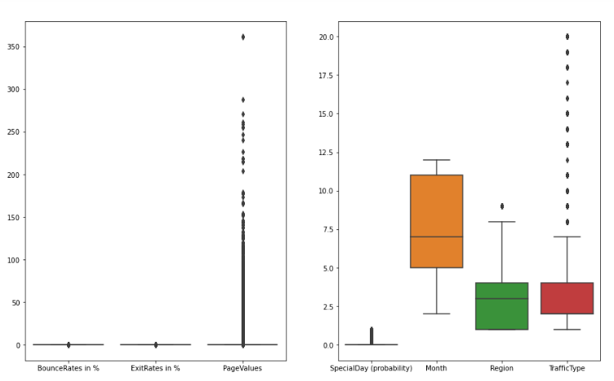
Checking for Outliers

Slide 19
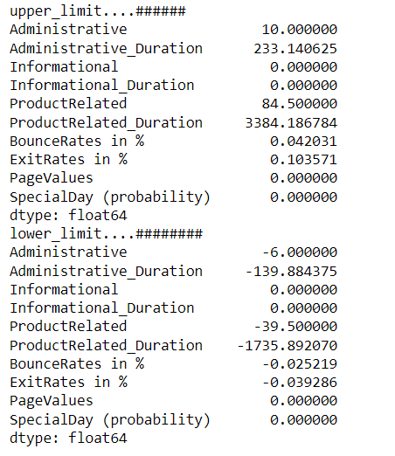
Checking for Outliers
There are huge outliers in the data as can be seen in the box plots.
Now to treat those outliers, IQR technique is used.
The upper and lower limits of outliers are calculated as follows:

Slide 20
Checking for Outliers
The columns Informational, Informational_Duration, PageValues, SpecialDay (probability) are removed as these are categorical columns.
The capping is done on the outliers on the non categorical columns.
Now six columns are to be given outlier treatment by capping their values.

Slide 21
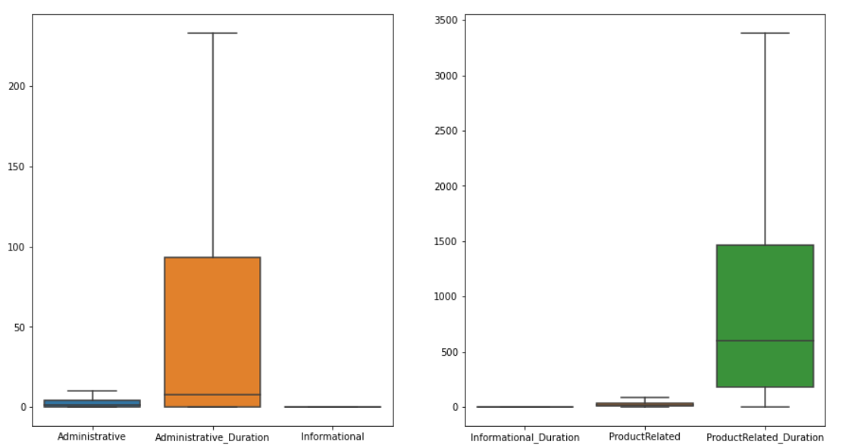
The outliers are removed and the columns do not have outliers anymore.

Slide 22
MULTI-COLLINEARITY ANALYSIS

Slide 23
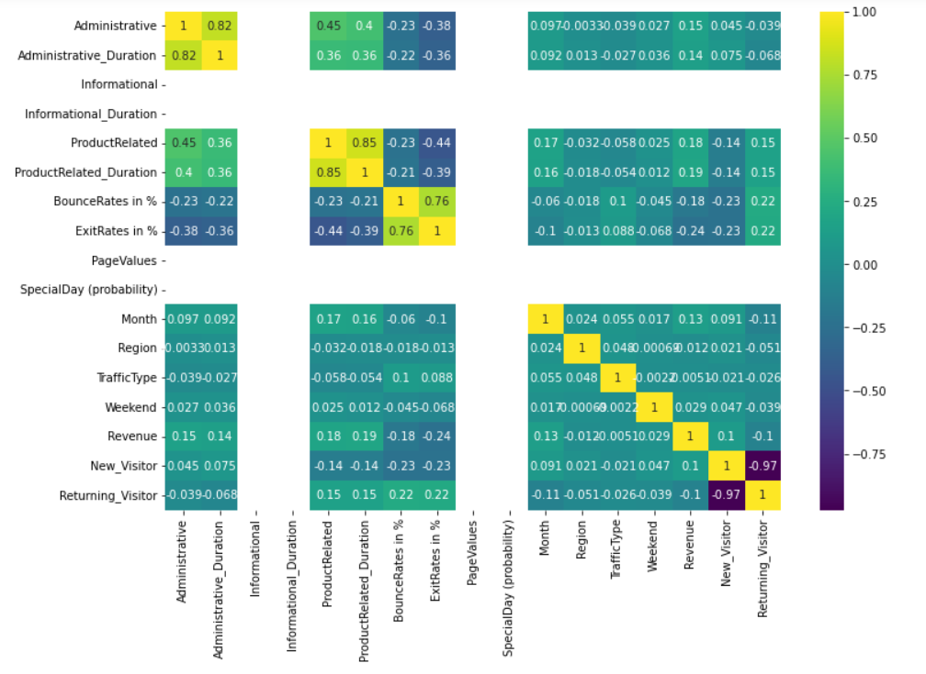
Correlation Matrix

Slide 24
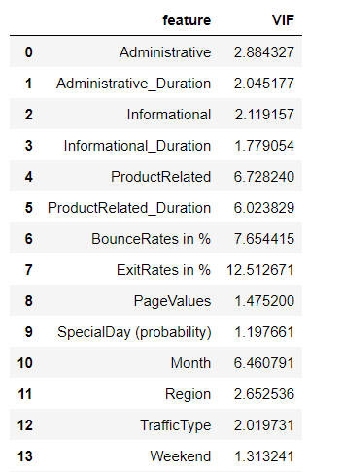
Variance Inflation Factor
The VIF is calculated for the columns as shown.

Slide 25
The columns ProductRelated, ProductRelated_Duration, BounceRates in %, ExitRates in % have very high values of VIF.
High values of VIF indicate the presence of multi collinearity in these columns.

Slide 26
IMBALANCED DATA

Slide 27
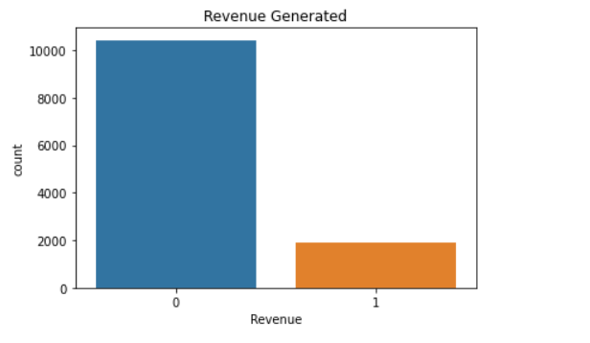
Target column (Revenue)
There is uneven and skewed distribution of data in the target column.
The data is imbalanced.

Slide 28
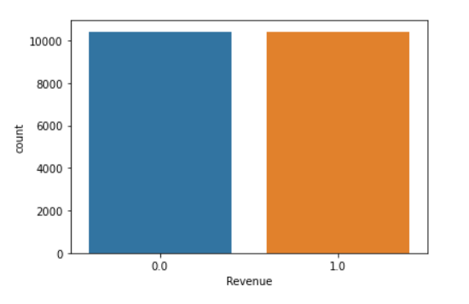
SMOTE Method
To balance the data, SMOTE method is used by oversamping the minority class, i.e., class 1.
The target column looks like this after balancing.

Slide 29
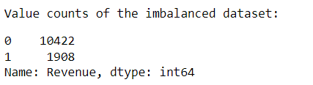
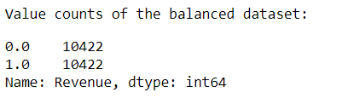
Initially, the Values for Class 0 and Class 1 were 10422 and 1908 respectively.
After balancing the data the values for Class 0 and Class 1 were 10422 and 10422 respectively.

Slide 30

TEST TRAIN SPLIT

Slide 31
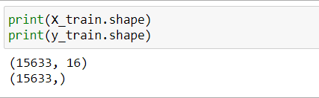
Train Test Split
Splitting the data into train set and set set.
75% of the data is used for training the models.
Rest 25% is used for testing the models.

Slide 32
MODELLING

Slide 33
Standardization & Regularization
Regularization is done on the data using MinMaxScaler.
After that data is standardized using Standardscaler.
Now, data is ready for training the models.

Slide 34
Model Selection
According to the problem statement, the problem is that of classification of shoppers whether they fall in revenue generating category or not.
For the current scenario three models have been selected, on which the modelling will be done.
The models that will be used in this project are:
Logistic Regression
Random Forests
Support Vector Machines (SVMs)

Slide 35

CLASSIFICATION REPORT

Slide 36
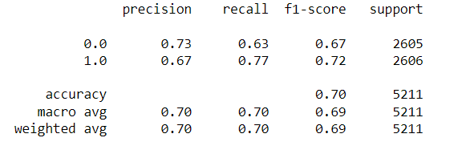
Logistic Regression
The R squared score of the model for test and train set is:
Classification report of the model for test set:

Slide 37
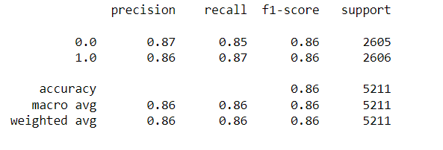
Random Forests
The R squared score of the model for test and train set is:
Classification report of the model for test set:

Slide 38
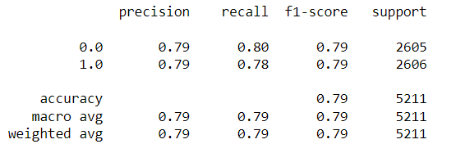
Logistic Regression
The R squared score of the model for test and train set is:
Classification report of the model for test set:

Slide 39
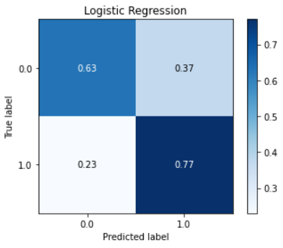
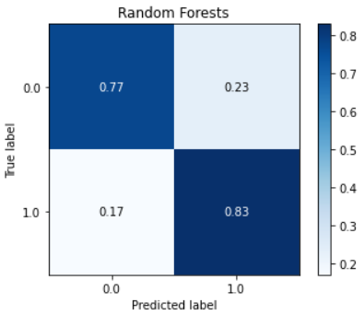
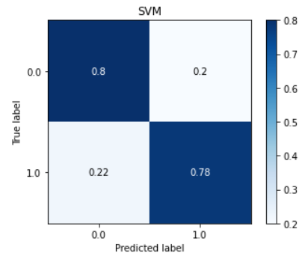
Comparing the Metrics of LogisticRegression, RandomForests and SVM

Slide 40
OBSERVATIONS

Slide 41
Observations
Random Forests algorithm is giving the best accuracy and model score for training and test data.
Model score of Random Forests is highest and Logistic Regression has the lowest model score.
Logistic Regression is not performing well on the test and train data due to existence of multicollinearity between the variables.
SVMs are performing well on train and test sets.

Slide 42

CONCLUSION

Slide 43
Conclusion
The SVMs and Random Forests can be deployed for classifying the shoppers intention as they are giving good accuracy.
The Logistic regression has the very bad performance with accuracy 70% on test set and 705 on train set.
The accuracy of the random forest model is 86% for test set and 96% for train set.
The accuracy of the SVM model is 79% for test set and 79% for train set.

Slide 44

THE END

